Slide 1
Paper 1-Fiction
Reading section A [40]
Read the extract and answer questions about it.
Writing section B [40]
Write your own narrative (story).
Total = /80marks

Slide 2
Language Paper 1
Section A (20%) – Reading of one prose extract (about 60-100 lines) of 20th century literature.
Answer questions. 40 marks. 1 hour
Section B (20%) – Prose Writing. 40 marks. 45 mins
One creative writing task selected from a choice of four titles.

Slide 3
Paper 1 Assessment objectives: Reading
READING (50% of overall qualification) Read and understand a range to texts to:
AO1 Identify and interpret explicit and implicit information and ideas. Select and synthesise evidence from different texts
AO2 Explain, comment on and analyse how writers use language and structure to achieve effects and influence readers, using relevant subject terminology to support their views
AO3 Compare writers' ideas and perspectives, as well as how these are conveyed, across two or more texts
AO4 Evaluate texts critically and support this with appropriate textual references
Each Reading question in our Eduqas specification targets a specific assessment objective

Slide 4
Paper 1 Assessment objectives - Writing
WRITING (50% of the overall qualification)
AO5 Communicate clearly, effectively, and imaginatively, selecting and adapting tone, style and register for different forms, purposes and audiences; Organise information and ideas, using structural and grammatical features to support coherence and cohesion of texts.
AO6 Candidates must use a range of vocabulary and sentence structures for clarity, purpose and effect, with accurate spelling and punctuation. (This requirement must constitute 20% of the marks for each specification as a whole.)

Slide 5
A1 questions
Focus on retrieving information
Can use a quotation, but you don’t have to
Try and make it your sentence/phrase rather than copying 5 words without reshaping anything.
You DO NOT need to explain anything!

Slide 6
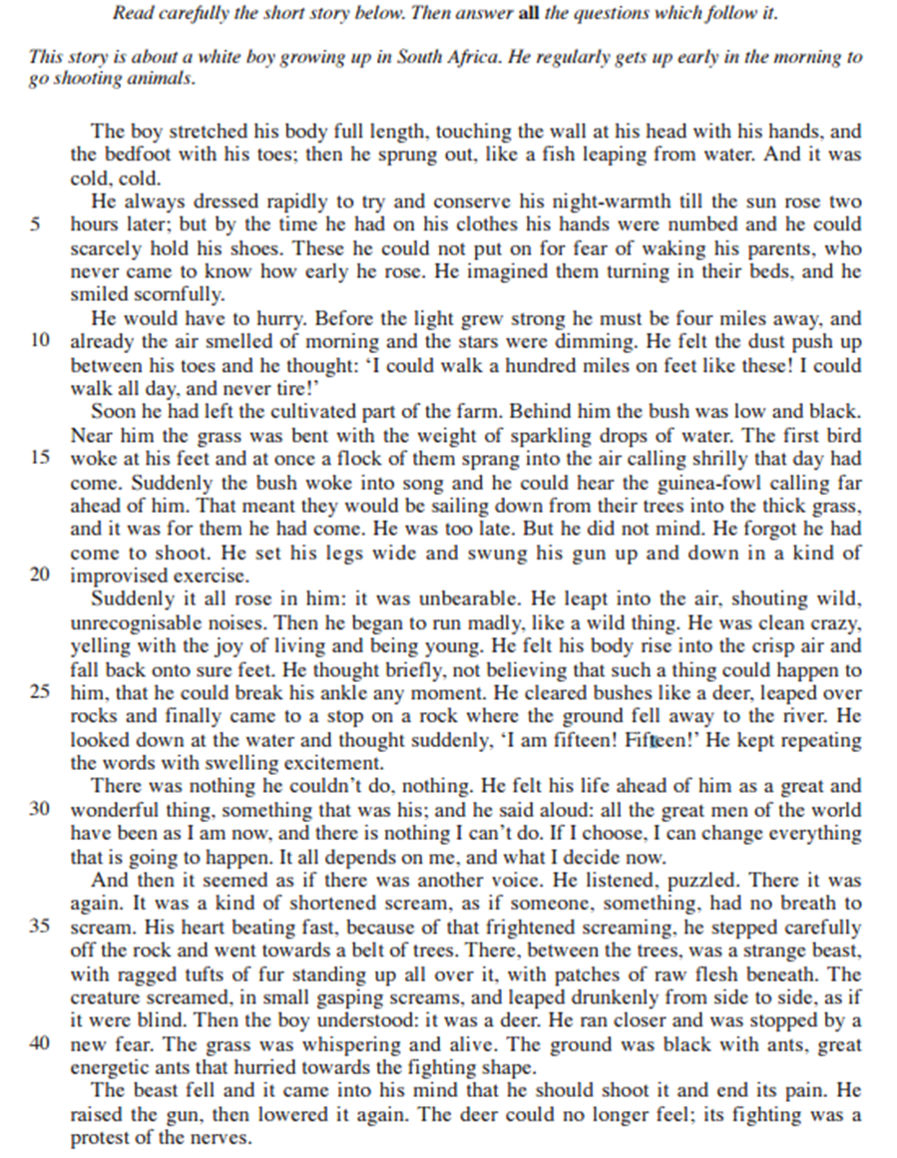
A1 – What are the boy’s feelings?

Slide 7
A1 – What are the boys feelings? Check:
He feels excited
Cold
Fearful, anxious, concerned
Smug
Rushed, anxious, enthusiastic
Energetic

Slide 8
A2 How does the writer’s use of language and structure show his excitement in lines 21-32? (5mks)
Focus on presentation of feelings
MUST use quotations
Use 3/4/5 quotations, depending on the length of your explanations-keep brief, and time available
Link together any similar ones
You MUST be able to label techniques and word types:
Techniques expected:
Simile
Metaphor
Personification
Exaggeration
Contrast
Repetition
Short sentences
Pathetic fallacy
Onomatopoeia
Word types to be aware of:
Noun
Verb
Adjective
Adverb
Pronoun
Preposition
Structure: paragraphs, dialogue, monologue, sentence structure/starters, punctuation for effect,

Slide 9
Which word types are in the extract below? Effect?
Suddenly it all rose in him: it was unbearable. He leapt into the air, shouting wild, unrecognisable noises. Then he began to run madly, like a wild thing. He was clean crazy, yelling with the joy of living and being young. He felt his body rise into the crisp air and fall back onto sure feet.
Nouns – things, feelings, ideas
Verbs – was/were/could etc. but also actions (ran, eating, spoke)
Preposition – in, on, over etc.
Adjective – describe nouns
Adverbs – time, manner, place
PS- this is an example of HOW YOU need to write in Section B, Creative Prose Writing.

Slide 10
A2 – Language and structure lines 21-32
He was watching me now as I opened the first packet of raisins. ‘Hey!’ he cried, grabbing my left wrist. ‘What’s happened to your hand?’
‘It’s nothing,’ I said, clenching the fist.
He made me open it up. The long scarlet mark lay across my palm like a burn. ‘Who did it?’ he shouted.
‘Was it Captain Lancaster?’
‘Yes, Dad, but it’s nothing.’
‘What happened?’ He was gripping my wrist so hard it almost hurt. ‘Tell me exactly what happened!’
I told him everything. He stood there holding my wrist, his face going whiter and whiter, and I could see the fury beginning to boil up dangerously inside him.
‘I’ll kill him!’ he softly whispered when I had finished. ‘I swear I’ll kill him!’ His eyes were blazing, and all the colour had gone from his face. I had never seen him look like that before. ‘Forget it, Dad.’
‘I will not forget it!’ he said. ‘You did nothing wrong and he had absolutely no right to do this to you. So he called you a cheat, did he?’
I nodded. He had taken his jacket from a peg on the wall and was putting it on.
‘Where are you going?’ I asked.
‘I am going straight to Captain Lancaster’s house and I’m going to beat the living daylights out of him.’
‘No!’ I cried, catching hold of his arm. ‘Don’t do it, Dad, please! It won’t do any good! Please don’t do it!’
‘I’ve got to,’ he said.
‘No!’ I cried, tugging at his arm. ‘It’ll ruin everything! It’ll only make it worse! Please forget it!’

Slide 11
He was no longer able to contain his excitement, ‘it all rose in him:’ once he was free and out in the bush, it was almost painful. The verb ‘rose’ indicates it was all bubbling up inside him like a cork ready to pop.
He is delighted to be free to run without constraint, ‘run madly… clean crazy’, the adverb madly implies he has almost lost his mind such is his delight at being out in the bush, on his own at the break of dawn.

Slide 12
Extension:
Based on this extract, what do you think of the boy at the beginning and end of this extract.
Has he changed. If so, how and why?

